Slide 1
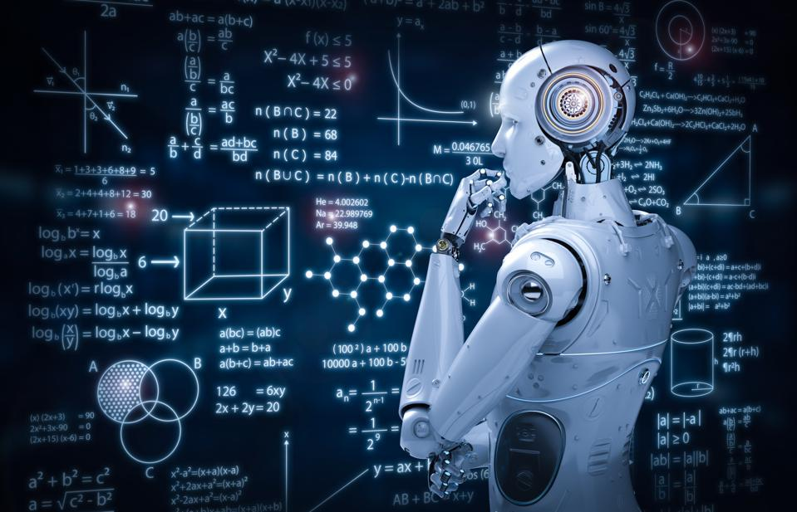

Prof. Dr. Hikmat Ullah Khan Department of Computer Science
Data Mining
Applications
UNIVERsity of sargodha

Slide 2

Lesson from Holy Quran

Slide 3

Outline
Introduction to Data Mining
Motivation
Applications of Data Mining
Real world
Diverse Datasets
Data Mining Typical Process
Semester Assignments and Project Role

Slide 4
Applications (Motivation)

Slide 5
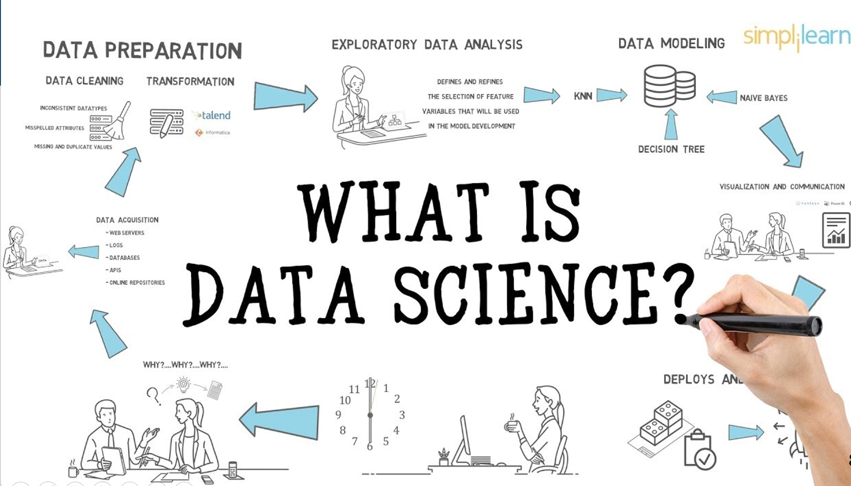

Slide 6
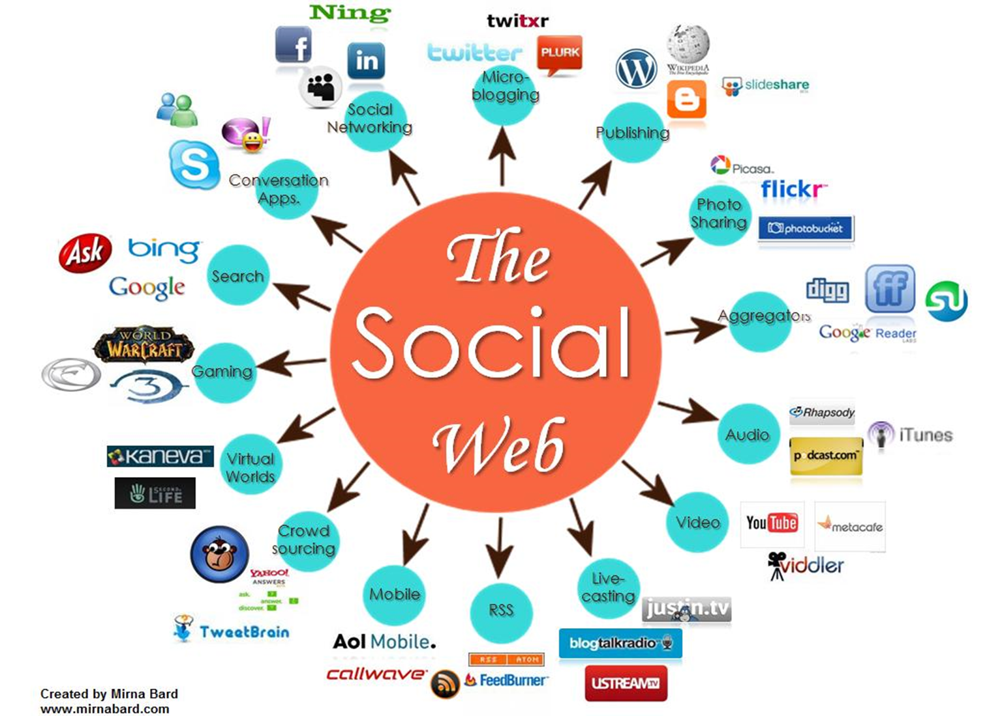
Applications (Motivation)

Slide 7
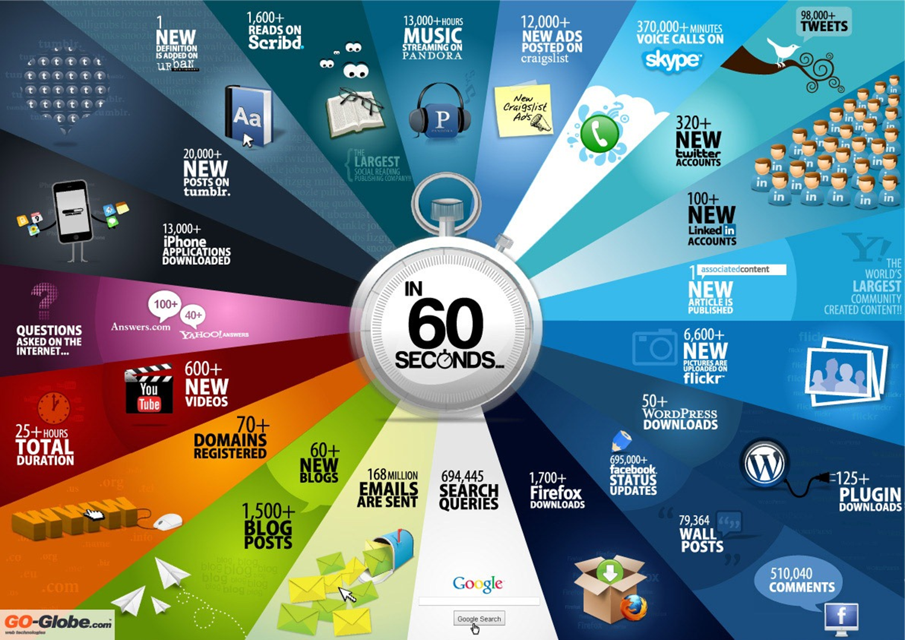
Applications (Motivation)

Slide 8
What is Data Mining?
Data mining
process of extracting and discovering patterns in large data sets
involving methods at the intersection of machine learning, statistics, and database systems.
Optimize a performance criterion using example data or past experience.
Role of Statistics: Inference from a sample
Role of Computer science: Efficient algorithms to
Solve the optimization problem
Representing and evaluating the model for inference

Slide 9
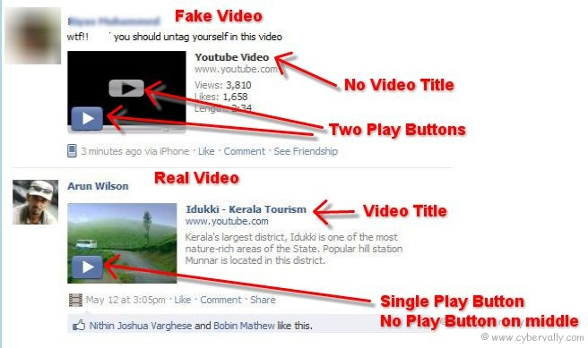
Real vs Fake

Slide 10
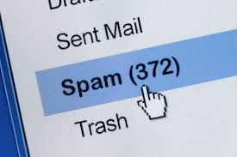
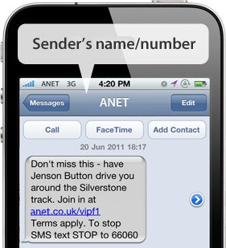
Spam detection
Spam Emails
Spam Messages
Spam Videos
Spam Techniques

Slide 11
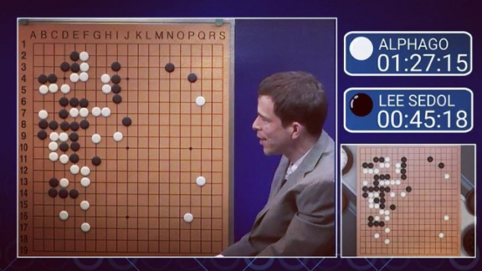
Google’s AlphaGo beat the world master as a game called Go

Slide 12
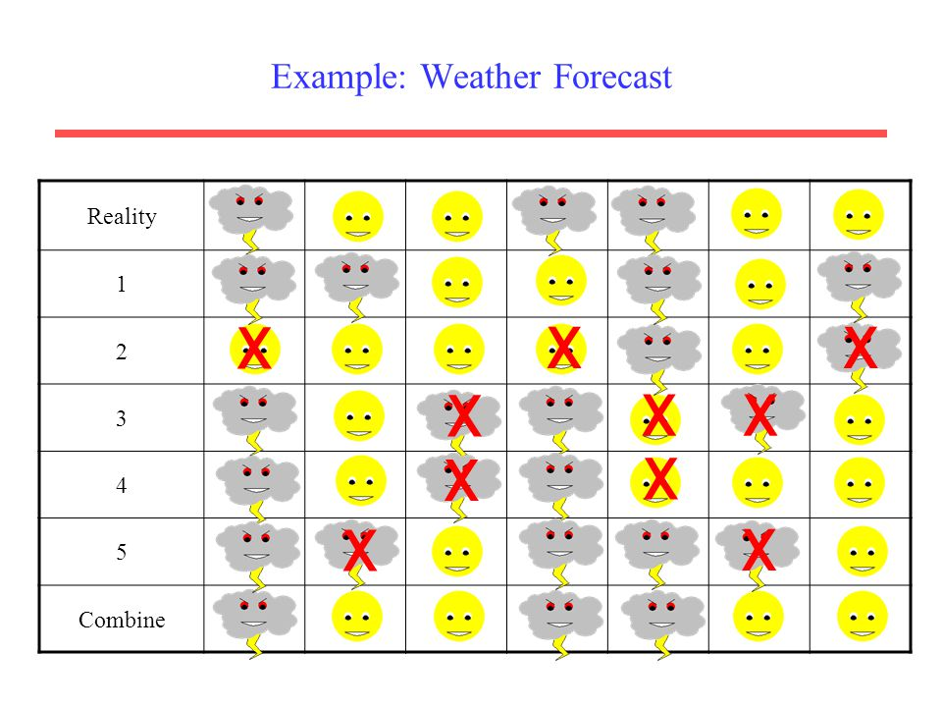
Weather Forecasting

Slide 13

Applications (Motivation)

Slide 14
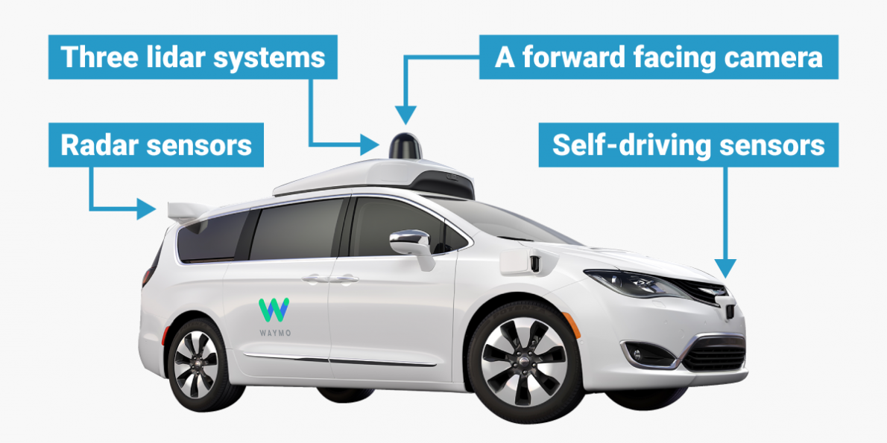
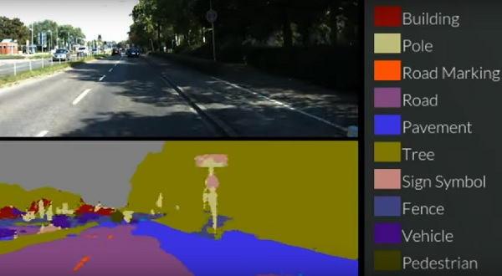
Self Driving

Slide 15
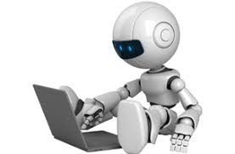
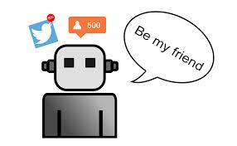
Social Bot (Rise and Hazards)

Slide 16
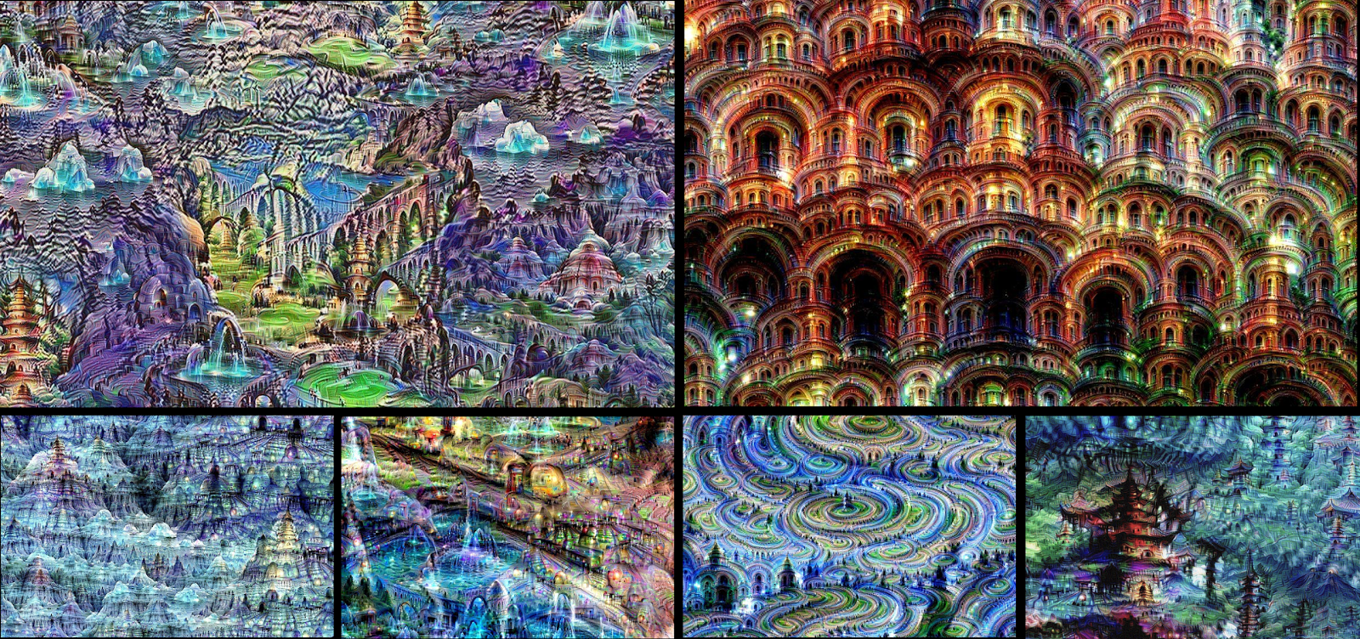
Google Machine’s Dream

Slide 17
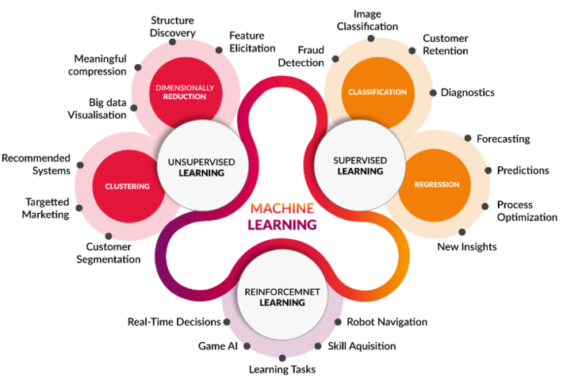
Applications of Data Mining

Slide 18
Role of Data Mining
Increasing potential
to support
business decisions
End User
Decision Making
Data Visualization
Business
Analyst
Visualization Techniques
Data Mining
Data
Analyst
Basic Data Analysis
Data Preprocessing
Data Sources
DBA

Slide 19
Process: A Typical View from ML
Pattern
Information
Knowledge
Input Data
Data Pre-Processing
Data Mining
Post-Processing
Data integration
Normalization
Feature selection
Dimension reduction
Pattern discovery
Association & correlation
Classification
Clustering
Outlier analysis
… … … …
Result evaluation
Pattern interpretation
Outcome visualization

Slide 20
Data Mining: On What Data?
Database-oriented data sets and applications
Relational database, data warehouse, transactional database
Advanced data sets and advanced applications
Text Datasets
Time-series data, temporal data,
Sequence data (incl. bio-sequences)
Graphs, social networks and multi-linked data
Object-relational databases
Heterogeneous databases
Multimedia database
The World-Wide Web
Social Web
BigData

Slide 21
Dig into Advanced Applications
Google’s DeepMind Lab
A Deep and Advanced Analysis of Data Mining
https://deepmind.com/
IBM Watson
Do your Work Best with IBM WATSON
https://www.ibm.com/watson/
DeepLearning
A comprehensive computation using Data Mining
http://deeplearning.net/
Top 15 Deep Learning Software of 2017
https://www.predictiveanalyticstoday.com/deep-learning-software-libraries/

Slide 22
Do you have any interest
What is the source of Interest
Motivation?
Reason
My Interest is PREDICTION (for instance)

Slide 23
Applications
Predicting the Risk of Chronic Disease: A Framework Based on Graph Theory and Social Network Analysis
Every team deserves a second chance: an extended study on predicting team performance.
Predicting of Job Failure in Compute Cloud Based on Online Extreme Learning Machine: A Comparative Study.
Predicting Patient Hospitalization after Emergency Readmission
Predicting computer proficiency in older adults.

Slide 24
Applications
Predicting epileptic seizures from scalp EEG based on attractor state analysis.
Predicting long-term product ratings based on few early ratings and user base analysis.
Predicting user behavior in electronic markets based on personality-mining in large online social networks - A personality-based product recommender framework.
Use of freely available datasets and Data Mining methods in predicting deforestation.

Slide 25
Applications Areas
Predicting academic success by using context variables and probabilistic classification.
Predicting the delay of issues with due dates in software projects.
Predicting the helpfulness of online reviews using a scripts-enriched text regression model.
Towards an ensemble based system for predicting the number of software faults.

Slide 26
Applications Areas
Predicting happiness: user interactions and sentiment analysis in an online travel forum.
A Data Mining Approach for Tracking and Predicting Student Performance in Degree Programs.
On Predicting Election Results using Twitter and Linked Open Data: The Case of the UK 2010 Election.
Predicting international Facebook ties through cultural homophily and other factors.

Slide 27
Applications Areas
Predicting Student Satisfaction and Outcomes in Online Courses Using Learning Activity Indicators.
On the feasibility of predicting popular news at cold start.
A deep learning approach for predicting the quality of online health expert question-answering services.
How are you feeling?: A personalized methodology for predicting mental states from temporally observable physical and behavioral information.

Slide 28
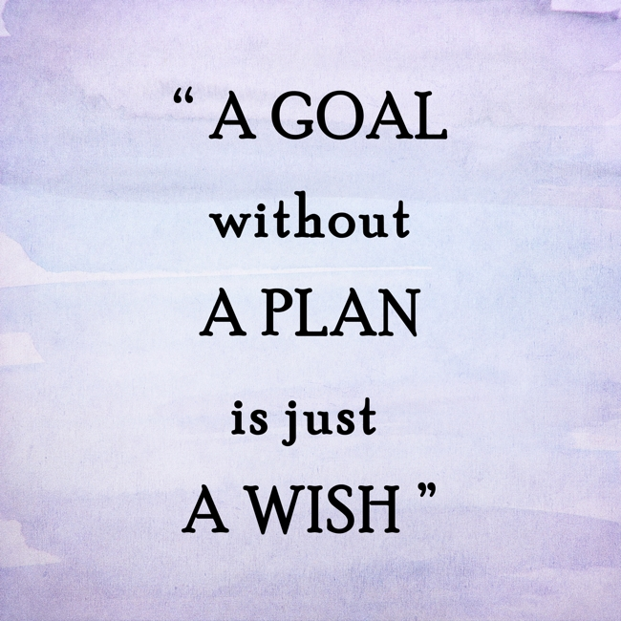
Lesson (Plan for Semester and its project)

